Slide 2
Some Useful Concepts

Slide 3

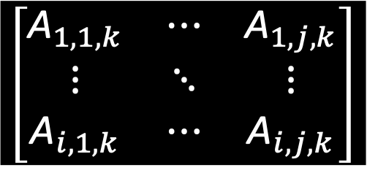

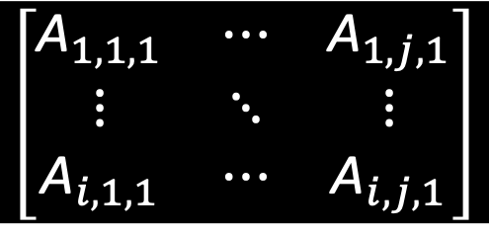

$$\left[\begin{aligned}x_{1} \\ x_{2} \\ ⋮ \\ x_{n}\end{aligned}\right]$$
$$x$$
$$\left[\begin{matrix}{\text{A}}_{1,1,k} & ⋯ & {\text{A}}_{1,j,k} \\ ⋮ & ⋱ & ⋮ \\ {\text{A}}_{i,1,k} & ⋯ & {\text{A}}_{i,j,k}\end{matrix}\right]$$
$$\left[\begin{matrix}A_{1,1} & ⋯ & A_{1,j} \\ ⋮ & ⋱ & ⋮ \\ A_{i,1} & ⋯ & A_{i,j}\end{matrix}\right]$$
$$\left[\begin{matrix}{\text{A}}_{1,1,1} & ⋯ & {\text{A}}_{1,j,1} \\ ⋮ & ⋱ & ⋮ \\ {\text{A}}_{i,1,1} & ⋯ & {\text{A}}_{i,j,1}\end{matrix}\right]$$

Slide 4
Artificial Intelligence
Artificial Intelligence (AI): creating an artificial brain capable of doing as a human brain;
Machine Learning (ML): automatically learning rules from the data;
Deep Learning (DL): improving the learning by succesively layering the representation of the data;
Machine Learning
Feature Learning
Deep Learning
An Euler diagram of the common imbrication of concepts

Slide 5
 | Machine Learning | Deep Learning
Python | scikit-learn | Keras Tensorflow Theano
R | caret tidymodels SuperLearner
Matlab |  | Tensorflow
Julia
Notes:
Pedregosa, F., and Coauthors, 2011: Scikit-learn: Machine Learning in Python. Journal of Machine Learning Research, 12, 2825–2830.
Kuhn, M., 2020: caret: Classification and Regression Training.
Kuhn, M., and H. Wickham, 2020: Tidymodels: a collection of packages for modeling and machine learning using tidyverse principles.
Chollet, F. and others, 2015: Keras.
Polley, E., E. LeDell, C. Kennedy, and M. van der Laan, 2021: SuperLearner: Super Learner Prediction.
Martín Abadi, and Coauthors, 2015: TensorFlow: Large-Scale Machine Learning on Heterogeneous Systems.

Slide 6
Machine Learning

Slide 7
Scalars
Vectors
Matrices
Multidimensional Array

Slide 8
Chollet, F., 2018: Deep learning with Python. Manning Publications Co, 361 pp.
Rules
Classical Programming
Answers
Data

Slide 9
Chollet, F., 2018: Deep learning with Python. Manning Publications Co, 361 pp.
Data
Machine Learning
Rules
Answers

Slide 10
Learning | Description
Unsupervised | Many features, learn useful properties of the structure of the dataset
Supervised | Involved labels or targets to inherit features associated to each label/target
Reinforcement | Feedback loop between learning system and its experiences

Slide 11
Text Analytics
Image Classification
Anomaly Detection
Recommenders
Purpose
Regression
Multiclass Classification
Clustering
Two-class Classification

Slide 12
Text Analytics
Image Classification
Anomaly Detection
Recommenders
Purpose
Regression
Multiclass Classification
Clustering
Two-class Classification

Slide 13
Text Analytics
Image Classification
Anomaly Detection
Recommenders
Purpose
Regression
Multiclass Classification
Clustering
Two-class Classification

Slide 14
Clustering

Slide 15
Climate is characterized by nonlinearity and high dimensionality
Challenges:
reducing dimensionality of the system,
finding the most important patterns explaining the variations.
Techniques to extract coherent patterns:
Empirical Orthogonal Functions (EOF): Preisendorfer (1988)
Singular Value Decomposition (SVD): Wallace et al. (1992)
K-means: Fauchereau et al. (2009)
Canonical Correlation Analysis (CCA): Barnett and Preisendorfer (1987)
Independent Component Analysis (ICA): Basak et al. (2004)
Self-Organizing Map (SOM)
...
Notes:
Preisendorfer, R. W., 1988: Principal component analyses in meteorology and oceanography. Elsevier, 425 pp.
Wallace, J. M., C. Smith, and C. S. Bretherton, 1992: Singular Value Decomposition of Wintertime Sea Surface Temperature and 500-mb Height Anomalies. Journal of Climate, 5, 561–576, https://doi.org/10.1175/1520-0442(1992)005<0561:SVDOWS>2.0.CO;2.
Fauchereau, N., B. Pohl, C. J. C. Reason, M. Rouault, and Y. Richard, 2009: Recurrent daily OLR patterns in the Southern Africa/Southwest Indian Ocean region, implications for South African rainfall and teleconnections. Clim. Dyn., 32, 575–591, https://doi.org/10.1007/s00382-008-0426-2.
Barnett, T. P., and R. Preisendorfer, 1987: Origins and Levels of Monthly and Seasonal Forecast Skill for United States Surface Air Temperatures Determined by Canonical Correlation Analysis. Mon. Wea. Rev., 115, 1825–1850, https://doi.org/10.1175/1520-0493(1987)115<1825:OALOMA>2.0.CO;2.
Basak, J., A. Sudarshan, D. Trivedi, and M. S. Santhanam, 2004: Weather Data Mining Using Independent Component Analysis. Journal of Machine Learning Research, 5, 239–253.

Slide 16
Climate is characterized by nonlinearity and high dimensionality
Challenges:
reducing dimensionality of the system,
finding the most important patterns explaining the variations.
Techniques to extract coherent patterns:
Empirical Orthogonal Functions (EOF)
Singular Value Decomposition (SVD)
Canonical Correlation Analysis (CCA)
Independent Component Analysis (ICA)
k-means
Self-Organizing Map (SOM)
...

Slide 17
Climate is characterized by nonlinearity and high dimensionality
Challenges:
reducing dimensionality of the system,
finding the most important patterns explaining the variations.
Techniques to extract coherent patterns:
Empirical Orthogonal Functions (EOF)
Singular Value Decomposition (SVD)
Canonical Correlation Analysis (CCA)
Independent Component Analysis (ICA)
k-means
Self-Organizing Map (SOM)
...
Unsupervised

Slide 18
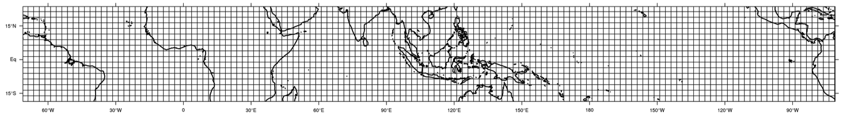
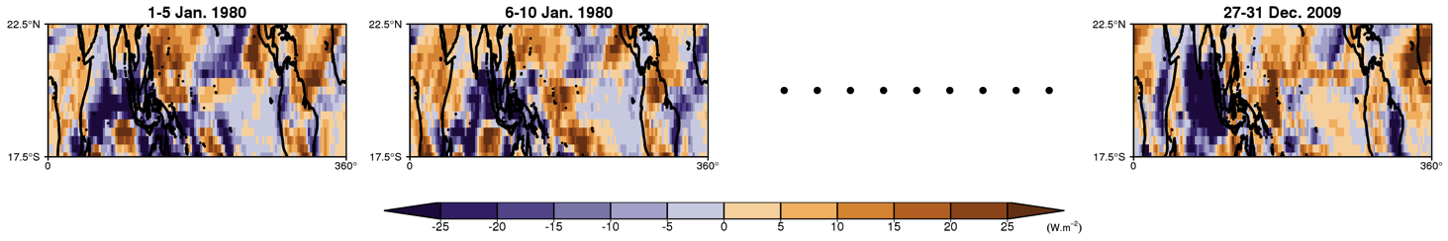
Input data
For the period 1980-2009, daily OLR (Liebmann and Smith 1996) filtered with a 20-100-day Lanczos bandpass filter (Duchon 1979, CLIVAR MJO Workgroup 2009), over the tropical region (0 – 360, 17.5°S – 22.5°N),
5-day anomalies from January to December (73 pentads) x 30 years,
As a result, a matrix consisting of 2448 grid points and 2190 pentads of data.
Notes:
Liebmann, B., and C. A. Smith, 1996: Description of a Complete (Interpolated) Outgoing Longwave Radiation Dataset. Bull. Amer. Meteor. Soc., 77, 1275–1277.
Duchon, C. E., 1979: Lanczos Filtering in One and Two Dimensions. J. Appl. Meteor., 18, 1016–1022, https://doi.org/10.1175/1520-0450(1979)018<1016:LFIOAT>2.0.CO;2.
Waliser, D., and Coauthors, 2009: MJO Simulation Diagnostics. J. Clim., 22, 3006–3030, https://doi.org/10.1175/2008JCLI2731.1.

Slide 19
Unsupervised artificial neural network, used to produce a low-dimensional representation of high-dimensional datasets
Several description of an algorithmic clustering in the 1950’s by different independent researches
Official first description by H. Steinhaus in 1956
Term ”k-means” coined in 1967 by J. MacQueen
Notes:
Steinhaus, H., 1956: Sur la division des corps matériels en parties. Bulletin de l’Académie Polonaise des Sciences, IV, 801–804.
MacQueen, J., 1967: Some methods for classification and analysis of multivariate observations. Proceedings of the Fifth Berkeley Symposium on Mathematical Statistics and Probability, 1: Statistics, 281–297.

Slide 20
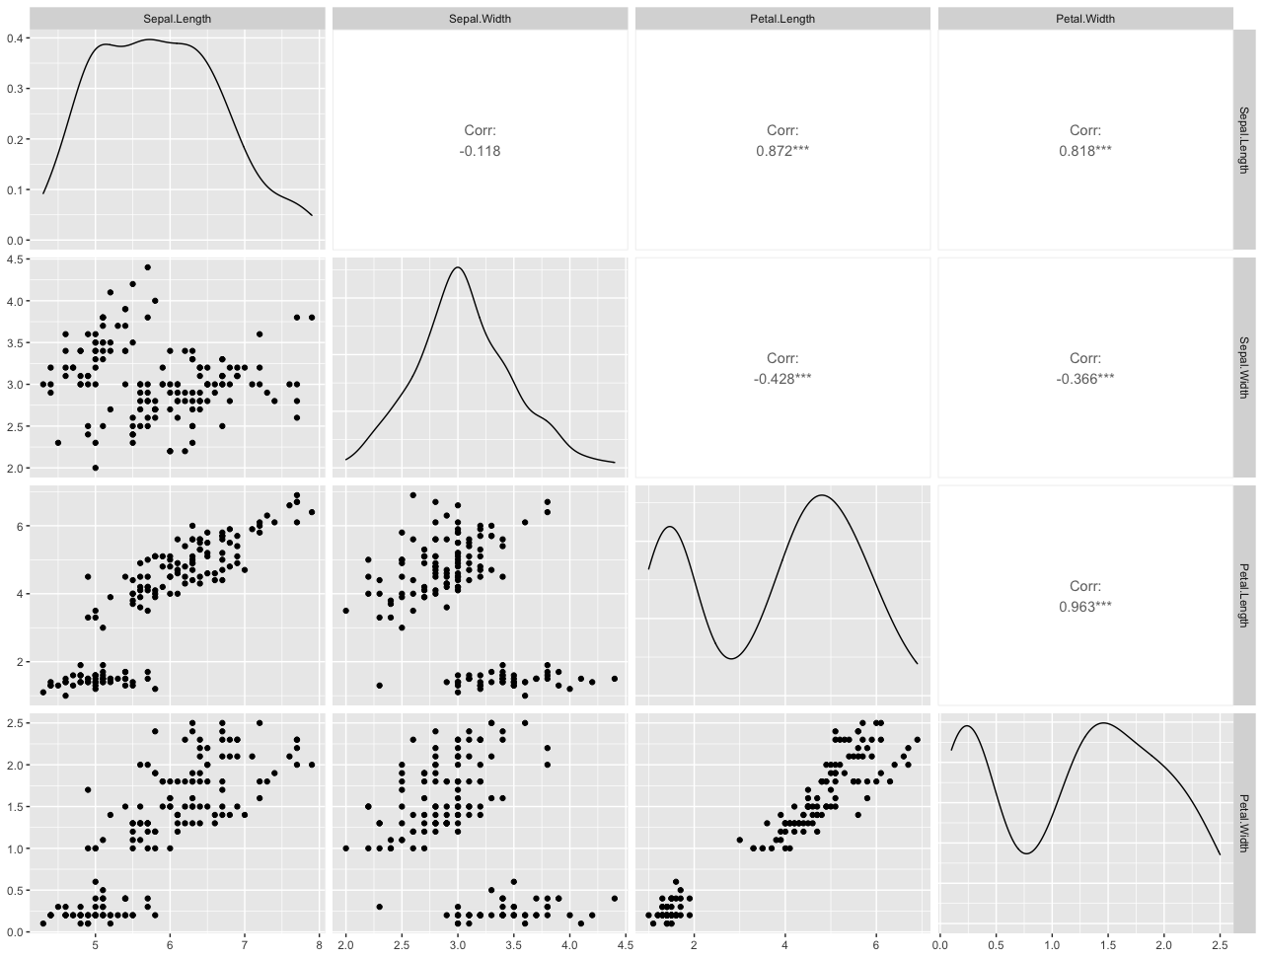
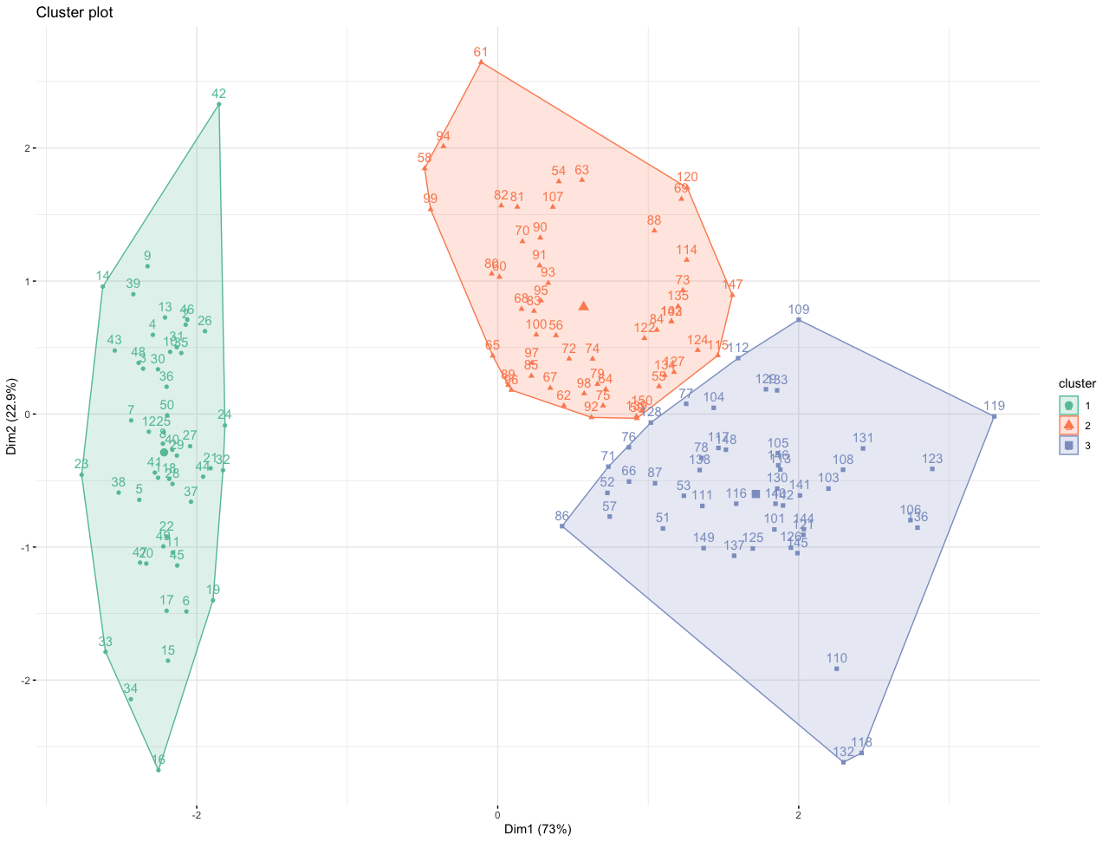
Deciding the number of classes,
Initializing to random centers,
Minimizing the intra-class variance and maximizing the inter-class variance
Algorithm | Lloyd/Forgy MacQueen Hartigan-Wong
k | Number of clusters

Slide 21
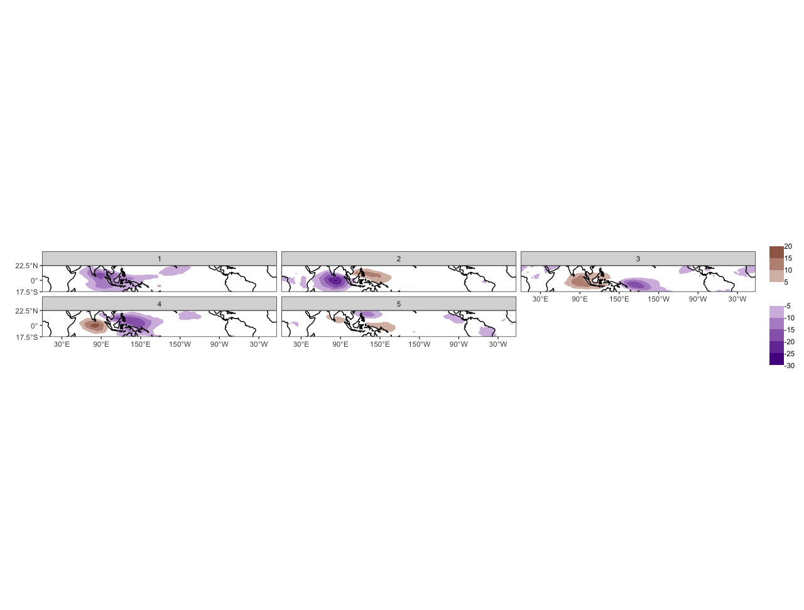
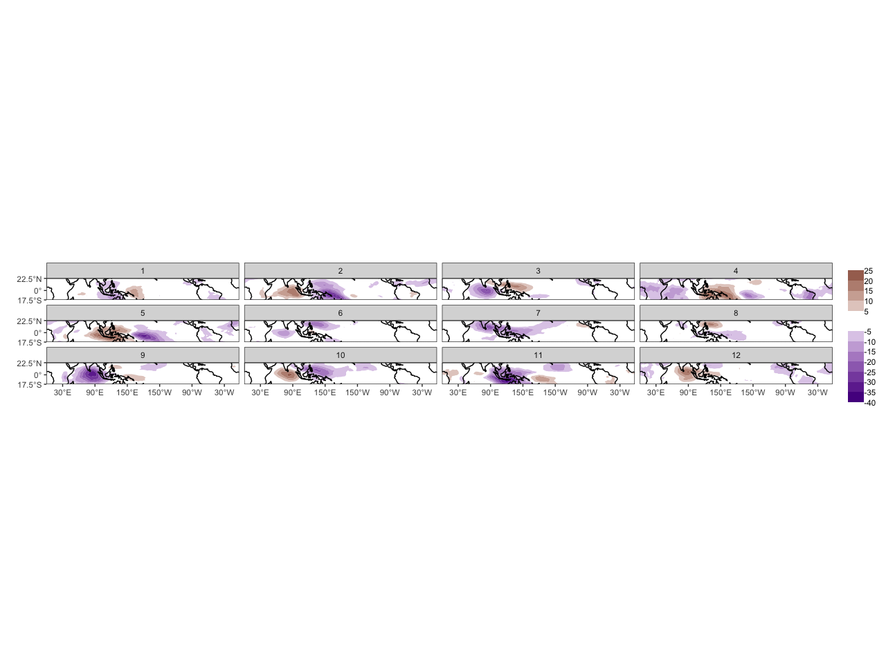
How to choose the optimal number for k?
Notes:
Lloyd, S. P., 1957, published 1982: Least squares quantization in PCM. IEEE Transactions on Information Theory, 28, 129–137, https://doi.org/10.1109/TIT.1982.1056489.
Forgy, E. W., 1965a: Cluster analysis of multivariate data: Efficiency versus interpretability of classification. WNAR Meetings, Riverside, California.
——, 1965b: Cluster analysis of multivariate data: Efficiency versus interpretability of classification (Abstract). Biometrics, 21, 768–769.
MacQueen, J., 1967: Some methods for classification and analysis of multivariate observations. Proceedings of the Fifth Berkeley Symposium on Mathematical Statistics and Probability, 1: Statistics, 281–297.
Hartigan, J. A., and M. A. Wong, 1979: Algorithm AS 136: A k-means clustering algorithm. Journal of the Royal Statistical Society. Series C (Applied Statistics), 28, 100–108, https://doi.org/10.2307/2346830.
Morissette, L., and S. Chartier, 2013: The k-means clustering technique: General considerations and implementation in Mathematica. TQMP, 9, 15–24, https://doi.org/10.20982/tqmp.09.1.p015.

Slide 22
Technique | Description
average silhouette width | Measures of how similar an object is to its own cluster (cohesion) compared to other clusters (separation). Closer to +1 is better
total within sum of square | measures the total variability of the observations within each cluster. Smaller is better
gap statistics | Indicates where the biggest jump in within-cluster distance occurred
Notes:
Tibshirani, R., G. Walther, and T. Hastie, 2000: Estimating the number of clusters in a dataset via the gap statistic. J. R. Statist. Soc. B, 63, 411–423, https://doi.org/10.1111/1467-9868.00293.
Rousseeuw, P. J., 1987: Silhouettes: A graphical aid to the interpretation and validation of cluster analysis. J. Comput. Appl. Math., 20, 53–65, https://doi.org/10.1016/0377-0427(87)90125-7.

Slide 23
Example of Application

Slide 24
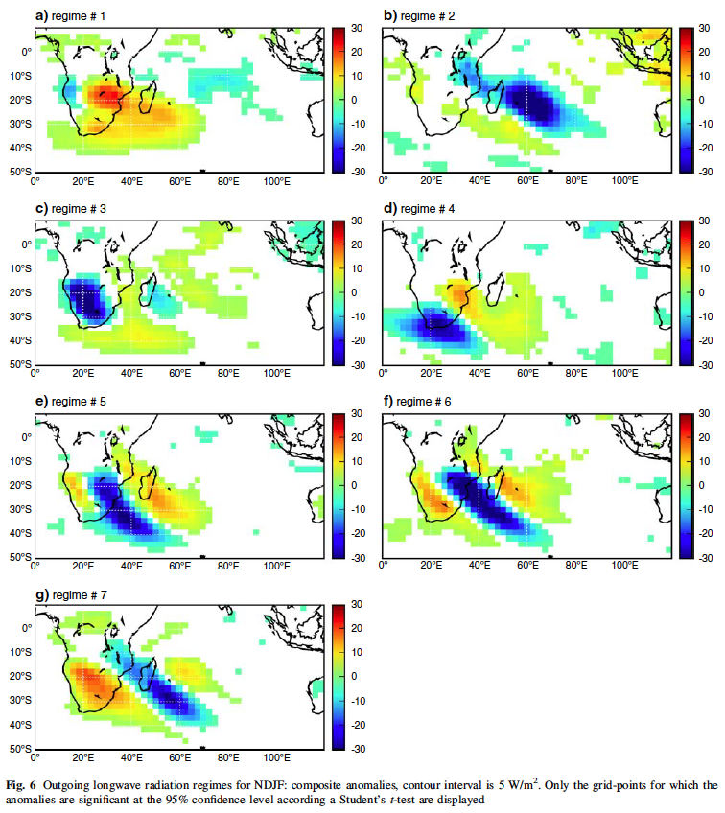
Fauchereau, N., B. Pohl, C. J. C. Reason, M. Rouault, and Y. Richard, 2009: Recurrent daily OLR patterns in the Southern Africa/Southwest Indian Ocean region, implications for South African rainfall and teleconnections. Clim. Dyn., 32, 575–591, https://doi.org/10.1007/s00382-008-0426-2.

Slide 25
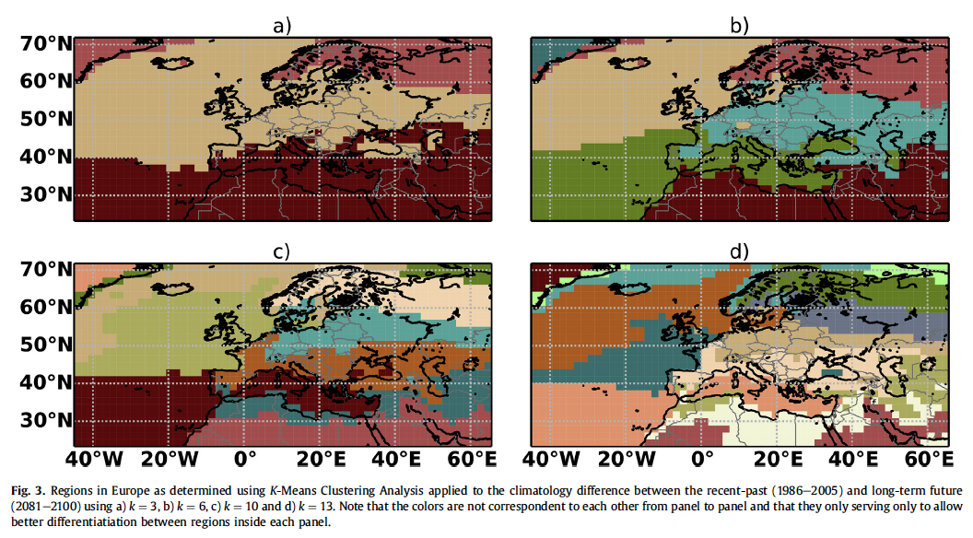
Carvalho, M. J., P. Melo-Gonçalves, J. C. Teixeira, and A. Rocha, 2016: Regionalization of Europe based on a K-Means Cluster Analysis of the climate change of temperatures and precipitation. Physics and Chemistry of the Earth, Parts A/B/C, 94, 22–28, https://doi.org/10.1016/j.pce.2016.05.001.

Slide 26
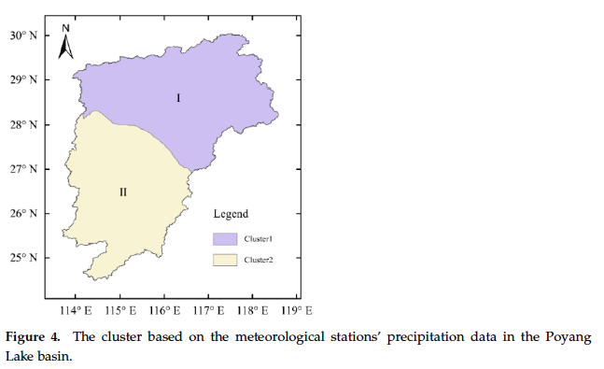
Lou, D., M. Yang, D. Shi, G. Wang, W. Ullah, Y. Chai, and Y. Chen, 2021: K-Means and C4.5 Decision Tree Based Prediction of Long-Term Precipitation Variability in the Poyang Lake Basin, China. Atmosphere, 12, 834, https://doi.org/10.3390/atmos12070834.

Slide 27
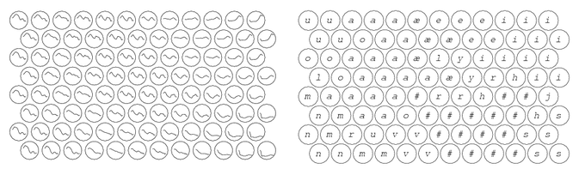
Another unsupervised artificial neural network, used to produce a low-dimensional representation of high-dimensional datasets
Developed by Prof. Teuvo Kohonen in the early 1980s
First application area of the SOM was speech recognition and speech-to-text transformation:
It follows the spatially ordered line detectors of von der Malsburg (1973) and the neural field model of Amari (1980)
System model composed of at two interacting subsystems of different nature: - competitive neural network - local synaptic plasticity of the neurons in learning modified by the network
Left: Models of acoustic spectra of Finnish phonemes, organized on an SOM
Right: Calibration of the models into phonemic classes
Notes:
Kohonen, T., 1982: Self-organized formation of topologically correct feature maps. Biol. Cybern., 43, 59–69, https://doi.org/10.1007/BF00337288.
von der Malsburg, C., 1973: Self-organization of orientation sensitive cells in the striate cortex. Kybernetik, 14, 85–100, https://doi.org/10.1007/BF00288907.
Amari, S., 1980: Topographic organization of nerve fields. Bulletin of Mathematical Biology, 42, 339–364, https://doi.org/10.1016/S0092-8240(80)80055-3.

Slide 28
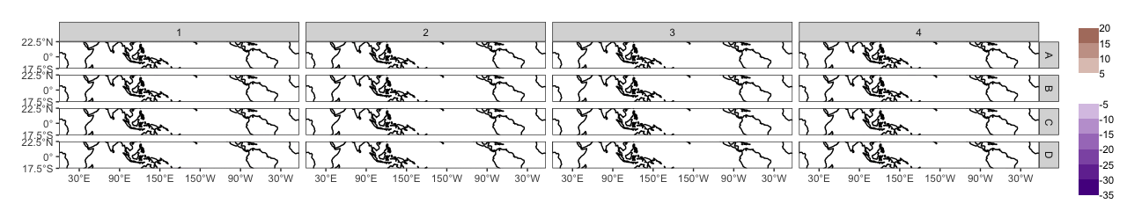
Random initialization
Deciding the dimension for the two-dimensional SOM array,
Initializing to random values,
Each node will finally represent a pattern of OLR anomalies in the study region.
4x4 Kohonen Map

Slide 29
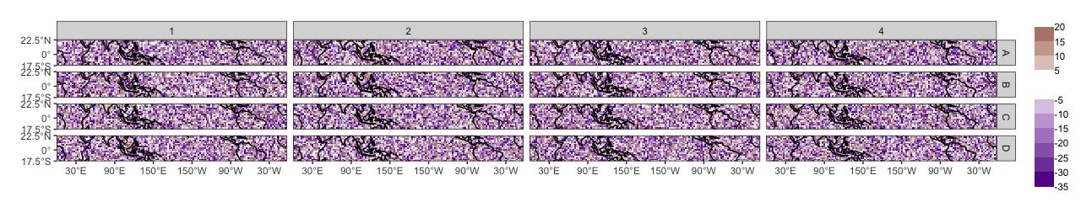
Random initialization
Deciding the dimension for the two-dimensional SOM array,
Initializing to random values,
Each node will finally represent a pattern of OLR anomalies in the study region.
4x4 Kohonen Map

Slide 30
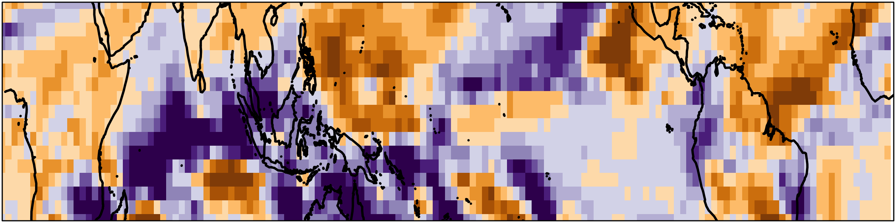

Input data
Larger initial learning rate (α) and neighborhood radius (r),
At each step in the training process, a node with the smallest Euclidean distance with the input data from 16 nodes is searched. This is called the best matching node:
Best matching node:
$$c=\arg{\min\left\{\left\|x−y_{ij}\right\|\right\}}$$
Euclidean distance
For step n, x(n) is an input data vector and y_{ij}(n) a reference vector of the Kohonen map

Slide 31
Input data
Larger initial learning rate (α) and neighborhood radius (r),
At each step in the training process, a node with the smallest distance with the input data from 16 nodes is searched. This is called the best matching node. This is called the “winner” node,
The winner node becomes the center of an update neighborhood ( ).
Notes:
Liu, Y., R. H. Weisberg, and C. N. K. Mooers, 2006: Performance evaluation of the self-organizing map for feature extraction. J. Geophys. Res., 111, C05018_1-C05018_14, https://doi.org/10.1029/2005JC003117.

Slide 32
Input data
Larger initial learning rate (α) and neighborhood radius (r),
At each step in the training process, a node with the smallest distance with the input data from 16 nodes is searched. This is called the best matching node. This is called the “winner” node,
The winner node becomes the center of an update neighborhood ( ).
After the training, the winner node and surrounding nodes, according to r, become like the input data. This process is repeated N times.
Notes:
Liu, Y., R. H. Weisberg, and C. N. K. Mooers, 2006: Performance evaluation of the self-organizing map for feature extraction. J. Geophys. Res., 111, C05018_1-C05018_14, https://doi.org/10.1029/2005JC003117.

Slide 33
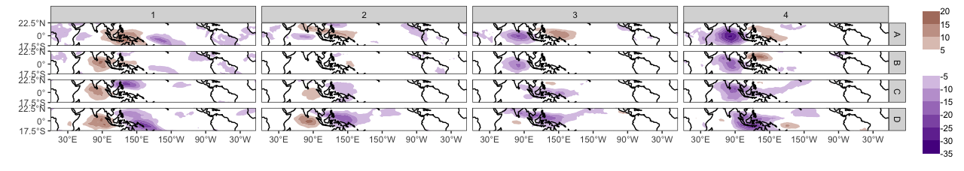
After a fine-tuning phase, with smaller learning rate and neighborhood radius, the randomized map...
… becomes the final map, with coherent spatial patterns of filtered OLR identified:

Slide 34
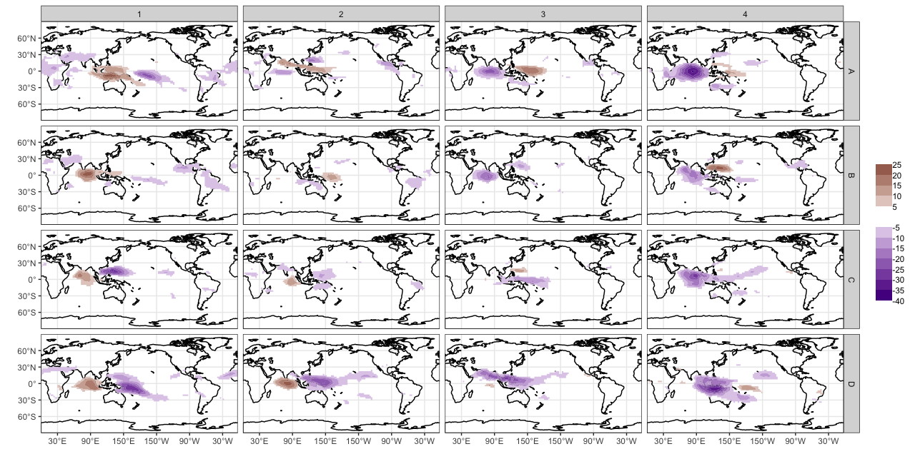
Kohonen map with 16 patterns of OLR anomalies, characteristic of input data
→ similar patterns nearby,
→ dissimilar patterns further apart.

Slide 35
Dimensions of the grid | Number of columns Number of rows
Topology | Rectangular Hexagonal
Neighborhood function | Bubble Gaussian
Radius of the neighborhood | Distance to define which node(s) to udate around the “winner” node.
Tuning length | Number of times the complete data set will be presented to the network.
Learning rate | Controls the size of weight vector in learning
Distance function | Sum of squares Euclidean

Slide 36
Quantization error | Average squared distance between the data points and the map's prototypes to which they are mapped. Lower is better.
Percentage of explained variance | The share of total variance that is explained by the clustering. Higher is better.
Topographic error | Measures how well the topographic structure of the data is preserved on the map. Lower is better
Kaski-Lagus error | Combines aspects of the quantization and topographic error.
Sammon mapping | Represents the relative position of the final nodes to each others. Closer the map is to the desired topology, better the clustering is.
Notes:
Kaski, S., and K. Lagus, 1996: Comparing self-organizing maps. Artificial Neural Networks — ICANN 96, C. Von der Malsburg, W. Von Seelen, J.C. Vorbrüggen, and B. Sendhoff, Eds., Lecture Notes in Computer Science, Berlin, Heidelberg, Springer, 809–814.
Bauer, H.-U., M. Herrmann, and T. Villmann, 1999: Neural maps and topographic vector quantization. Neural Networks, 12, 659–676, https://doi.org/10.1016/S0893-6080(99)00027-1.
Kiviluoto, K., 1996: Topology preservation in self-organizing maps. IEEE International Conference on Neural Networks, 1996, Vol. 1 of, IEEE International Conference on Neural Networks, 1996, 294–299 vol.1.
Sammon, J. W., 1969: A Nonlinear Mapping for Data Structure Analysis. IEEE T. Comput., C–18, 401–409, https://doi.org/10.1109/T-C.1969.222678.

Slide 37
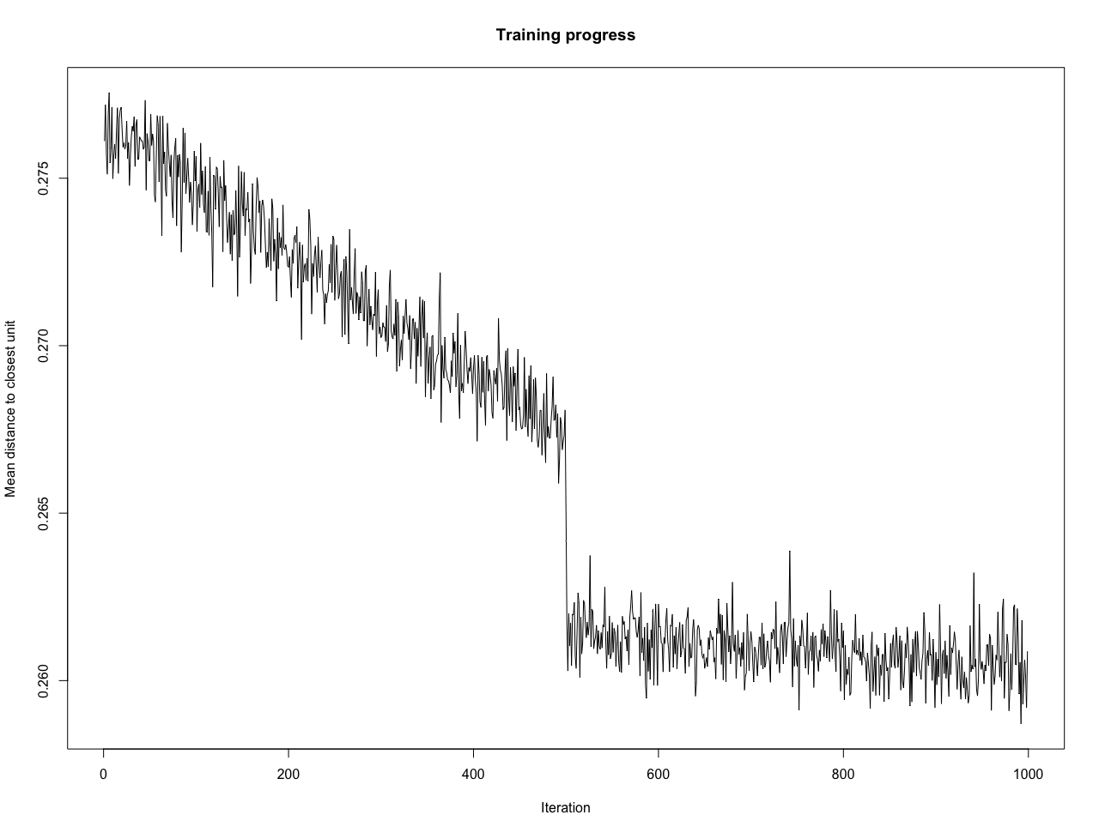
## Quality measures:
* Quantization error : 363537.3
* (% explained variance) : 14.99
* Topographic error : 0.09269406
* Kaski-Lagus error : 806.1191

Slide 38
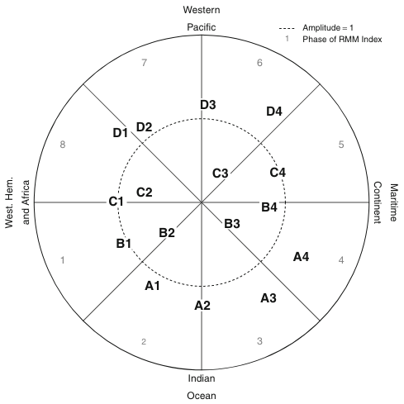
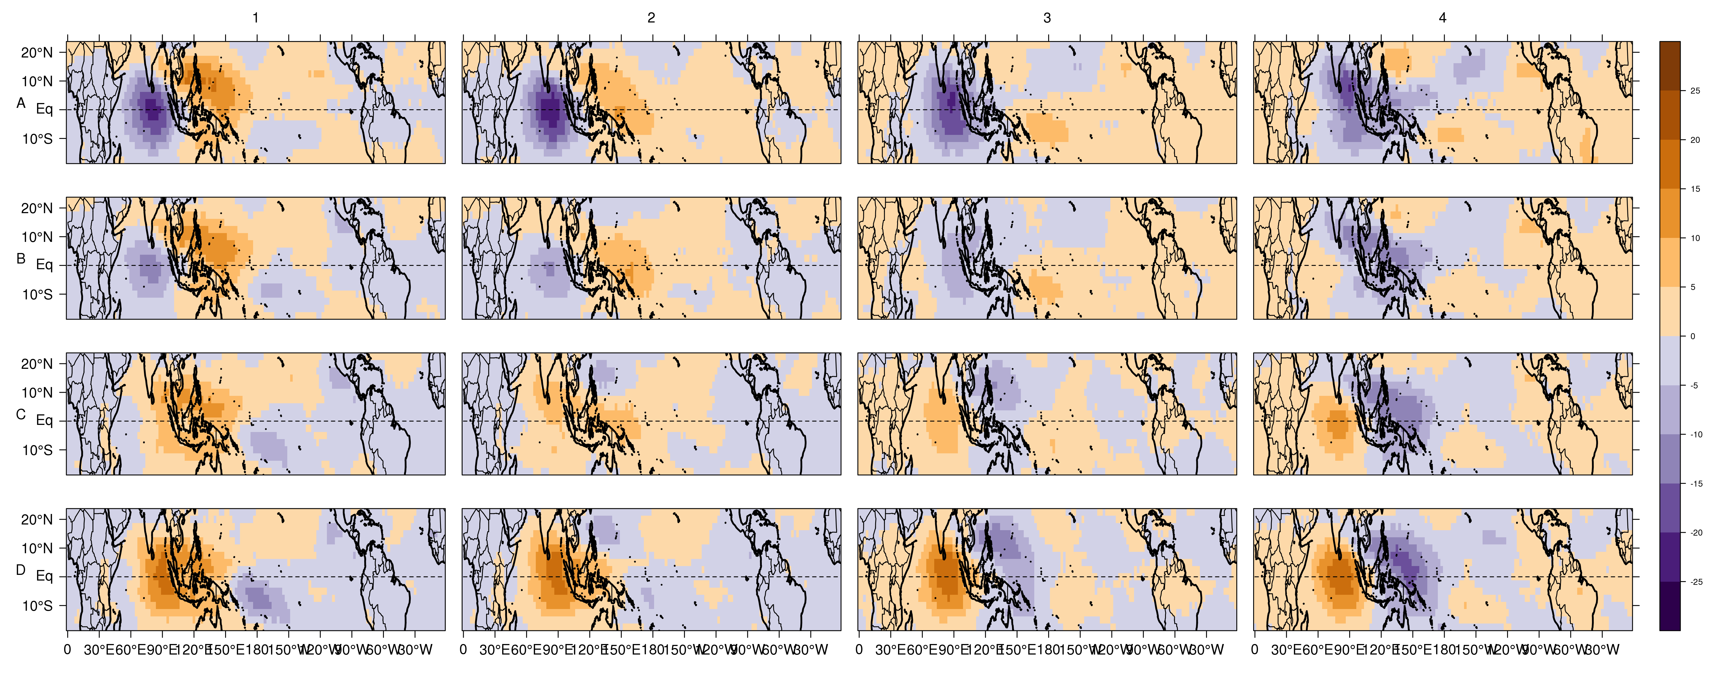
Oettli, P., T. Tozuka, T. Izumo, F. A. Engelbrecht, and T. Yamagata, 2014: The self-organizing map, a new approach to apprehend the Madden–Julian Oscillation influence on the intraseasonal variability of rainfall in the southern African region. Clim. Dyn., 43, 1557–1573, https://doi.org/10.1007/s00382-013-1985-4.

Slide 39
Some Advices

Slide 40
Number of partitions:
Techniques available to help to decide the optimal number in k-means
But often not enough, so:
Try different number of clusters for k-means
Try different grid dimension/topology for SOM
Evaluate the quality of the partition
Other settings influencing the quality of the partition:
k-means:
“Hartigan-Wong” algorithm generally performs better with high-dimensional data
SOM:
Neighborhood function
Distance function
Learning rate
Tuning length

Slide 41
Example of Application

Slide 42
Atmosphere

Slide 43
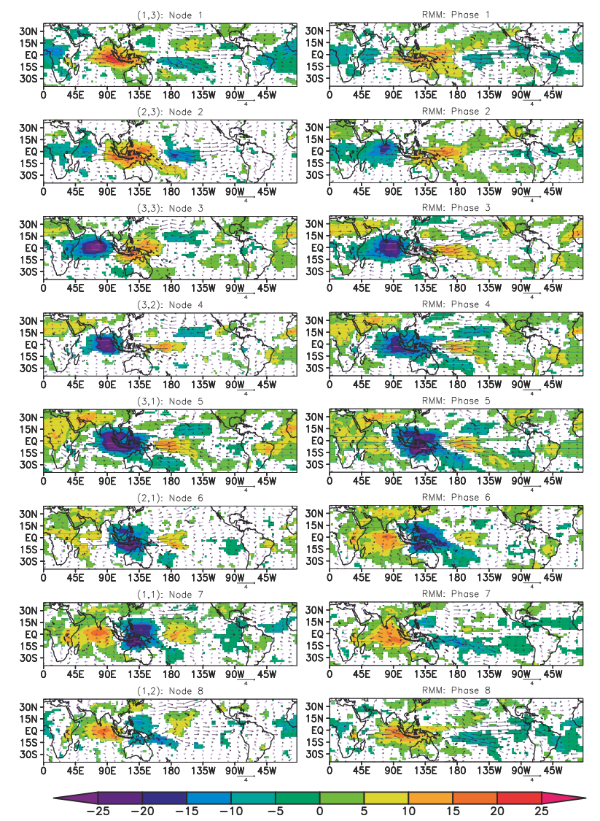
Chattopadhyay et al (2013)
Wheeler and Hendon (2004)
Chattopadhyay, R., A. Vintzileos, and C. Zhang, 2013: A description of the Madden–Julian oscillation based on a self-organizing map. J. Clim., 26, 1716–1732, https://doi.org/10.1175/JCLI-D-12-00123.1.
Wheeler, M. C., and H. H. Hendon, 2004: An all-season real-time multivariate MJO index: development of an index for monitoring and prediction. Mon. Weather Rev., 132, 1917–1932, https://doi.org/10.1175/1520-0493(2004)132<1917:AARMMI>2.0.CO;2.
(left) Composites of eight SOM nodes of OLR anomalies (colors; W·m⁻²) and wind vectors (m·s⁻¹) for November–April of 1979–2008.
(right) As in (left), but for RMM phase composites.

Slide 44
Chattopadhyay et al (2013)
Wheeler and Hendon (2004)
Chattopadhyay, R., A. Vintzileos, and C. Zhang, 2013: A description of the Madden–Julian oscillation based on a self-organizing map. J. Clim., 26, 1716–1732, https://doi.org/10.1175/JCLI-D-12-00123.1.
Wheeler, M. C., and H. H. Hendon, 2004: An all-season real-time multivariate MJO index: development of an index for monitoring and prediction. Mon. Weather Rev., 132, 1917–1932, https://doi.org/10.1175/1520-0493(2004)132<1917:AARMMI>2.0.CO;2.
(left) Composites of eight SOM nodes of OLR anomalies (colors; W·m⁻²) and wind vectors (m·s⁻¹) for November–April of 1979–2008.
(right) As in (left), but for RMM phase composites.

Slide 45
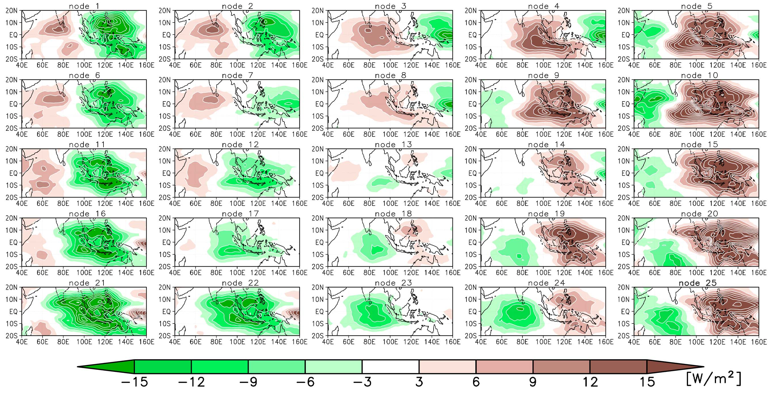
Daily OLR anomalies (40°E−160°E, 20°S−20°N) from 1 October to 31 March, for the period 1979–2009
Sakai, K., R. Kawamura, and Y. Iseri, 2010: ENSO-induced tropical convection variability over the Indian and western Pacific oceans during the northern winter as revealed by a self-organizing map. J. Geophys. Res., 115, https://doi.org/10.1029/2010JD014415.

Slide 46
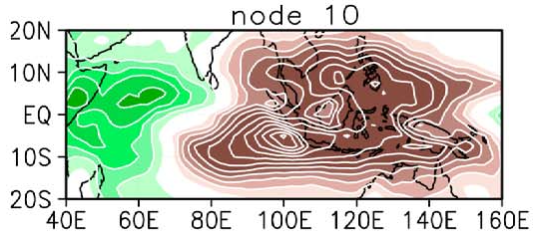
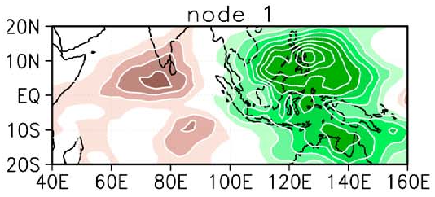
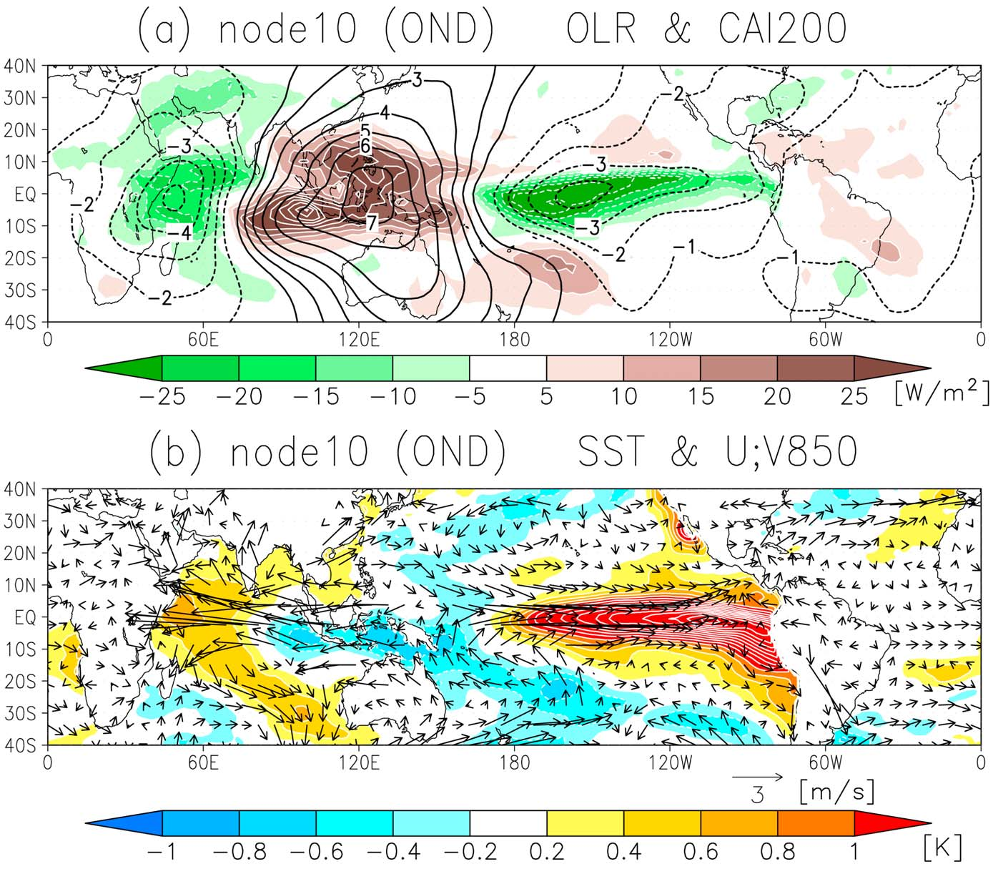
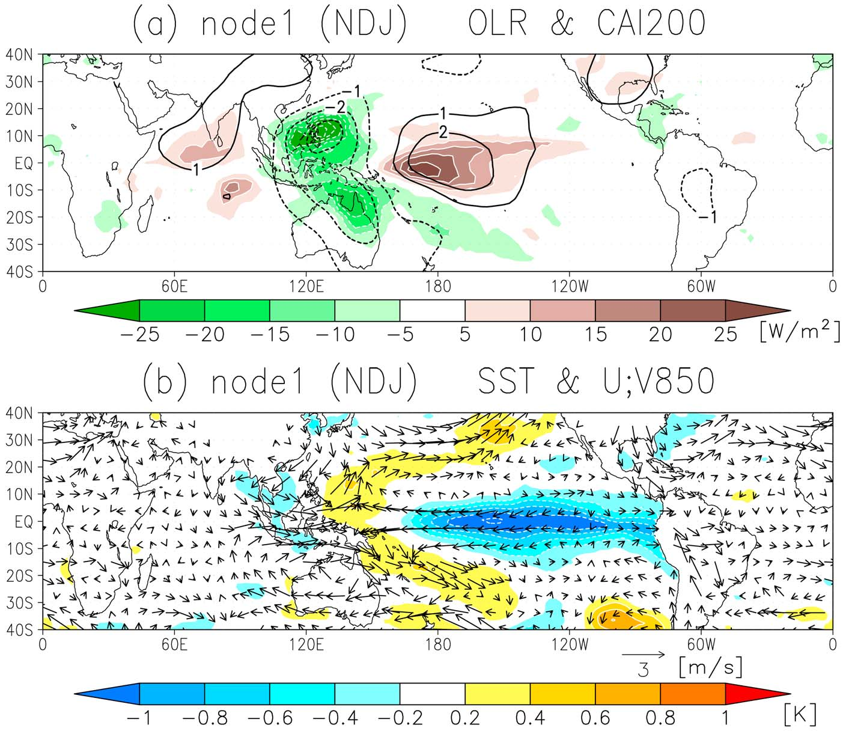

Slide 47
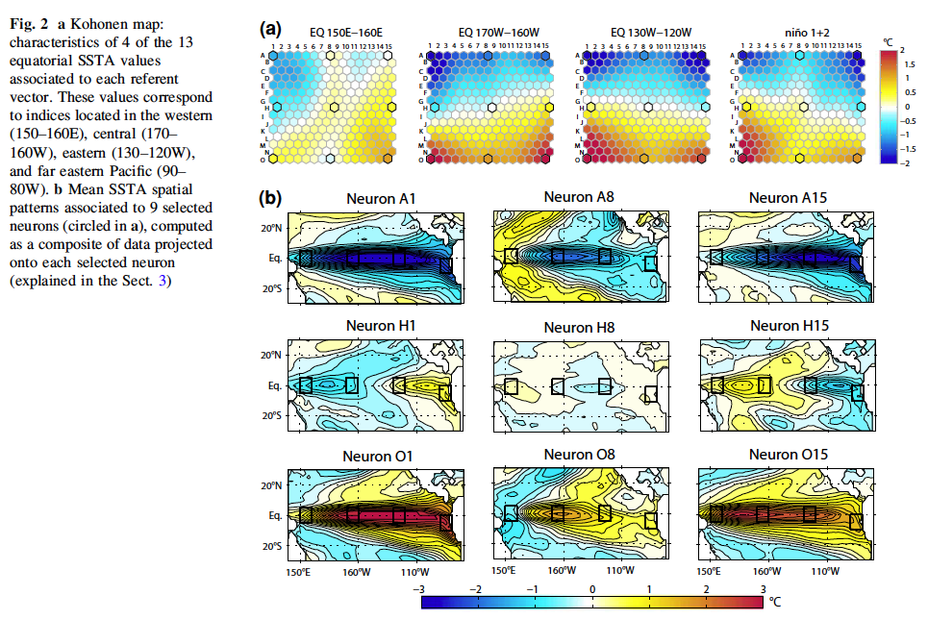

Slide 48
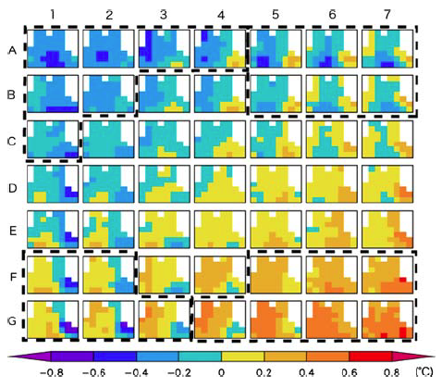
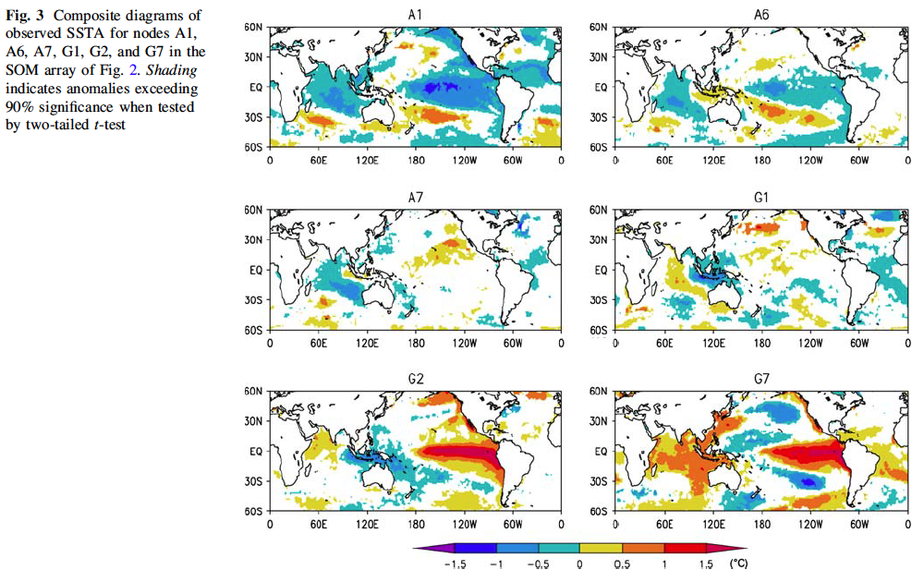

Slide 49
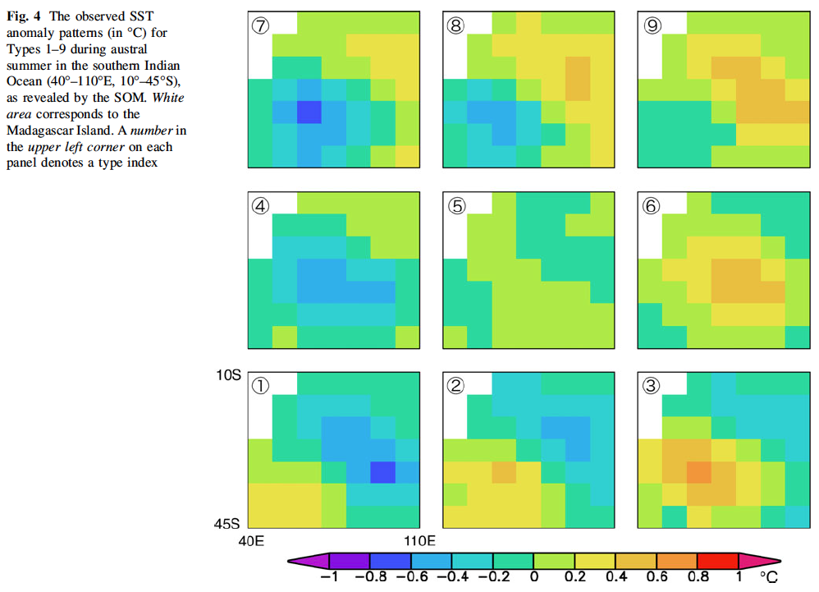
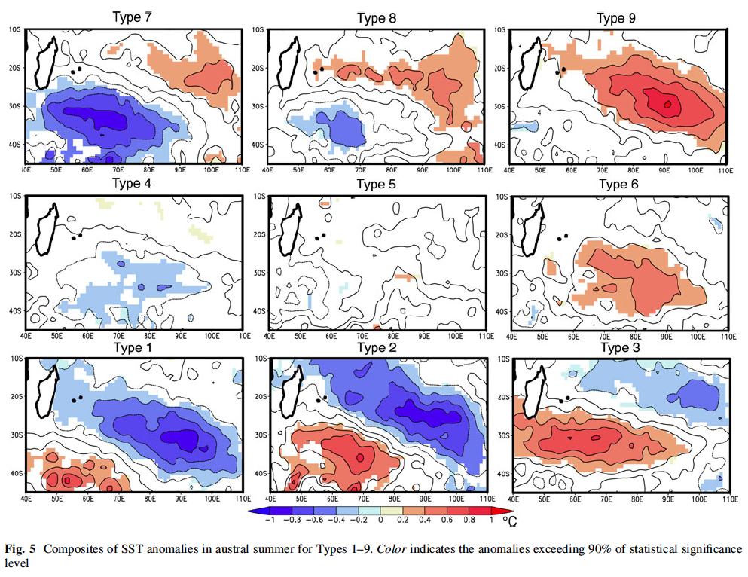

Slide 51
Regression

Slide 52
Learning a general model (=relationship) from data
Making forecasts from this model

Slide 53

Learning a general model (=relationship) from data
Making forecasts from this model
Linear Regression
Assumes a linear relationship between inputs X and output y;
Objective: minimizing the residual sum of squares (RSS) between observed output y and predicted output y’
$$RSS=\sum_{i=1}^{n}{{\left(y_{i}−f\left(x_{i}\right)\right)}^{2}}$$

Slide 54
Other Regression Methods

Slide 55
Regression Methods

Slide 56
Learning a general model (=relationship) from data
Making forecasts from this model
Linear Regression
Quantile Regression
Logistic Regression
Poisson Regression
Bayesian Linear Regression
Decision Tree/Forest Regression
Neural Network Regression
Boosted Decision Tree Regression

Slide 57
Linear Regression
Assumes a linear relationship between inputs X and output y; by minimizing the residual sum of squares (RSS)
Quantile Regression
Extension of the linear regression;
Estimates the conditional quantiles rather than the mean
Logistic Regression
Predicts the category of individuals;
Estimates the probability of category membership;
Poisson Regression
Predicts the count of individuals (i.e., the response variable following a Poisson distribution)

Slide 58
Bayesian Linear Regression BART machine
Considers various plausible explanations for how the data were generated;
Makes predictions using all possible regression weights, weighted by
their probability distribution.
Decision Tree/Forest Regression random forest
Fits several decision tree classifiers (which learn simple decision rules inferred from the data features) on various sub-samples of the dataset and uses averaging to improve the predictive accuracy
Boosted Decision Tree Regression XGBoost, CatBoost
Builds a strong classifier from several weak classifiers (typically decision trees), through iteration
Notes:
Previous regressions are said “Frequentist” i.e., the most plausible value of a paramater is used
In Bayesian perspective, a whole probability distribution for the unknown parameter is produced
Boosted Decision Tree: anomalies from precedent trees

Slide 59
Neural Network Regression (Multilayer Perceptron)
Mimics the human brain and how the neurons interact with each other, how they are activated and how they learn
Support-Vector Machine
Minimizes the coefficients in order to reach an acceptable error;
Different kernel functions (i.e., a pattern analysis to identify recurrent relationship in datasets) are available
K-Nearest Neighbors
Uses feature similarity, i.e., averages the observations in the same neighborhood to predict the outcome

Slide 60
Dataset
Decision Tree #1
Decision Tree #2
Decision Tree #D
Result #1
Result #2
Result #D
Majority voting / Averaging
Final result

Slide 61
Predictors
Regression Model
Machine Learning
Prediction
Outcome

Slide 62
Feature Selection
Predictors
Regression Model
Machine Learning
Prediction
Outcome

Slide 63
Feature Selection
Training Subset
Predictors
Regression Model
Machine Learning
Prediction
Outcome
Evaluation
Validation Subset
Several ML algortihms, each repeated several time, and eveluated to choose the most skillful one

Slide 64
Feature Selection

Slide 65
Technique | Description
Multicollinearity Check | Determines highly correlated variables, to remove collinearities
Variance Inflation Factor | Measure of the amount of multicollinearity in a set of multiple regression variables
Boruta | Iteratively compares the importance of attributes with their shuffled versions of the original attribute. All original attributes that have smaller importance than the shuffled version are dropped. Shuffling are re-created in each iteration. Random Forest algorithm is used to provide the variable importance measure
Genetic Algorithms | Machine learning search techniques inspired by Darwinian evolutionary models. Appropriate for finding solutions that require efficient searching of a subset of features to find combinations that are near optimal for solving high-dimensional regression

Slide 66
Some Advices

Slide 67
Splitting the data to improve the robustness of the model:
Training subset
Validation subset
Evaluation subset
During the training phase, using a resampling can help to reduce the overfitting:
cross-validation
leave-one-out
k-fold
boostrapping
time slices
A random search of the hyperparameters can be more efficient than a systematic search through a defined range of values

Slide 68
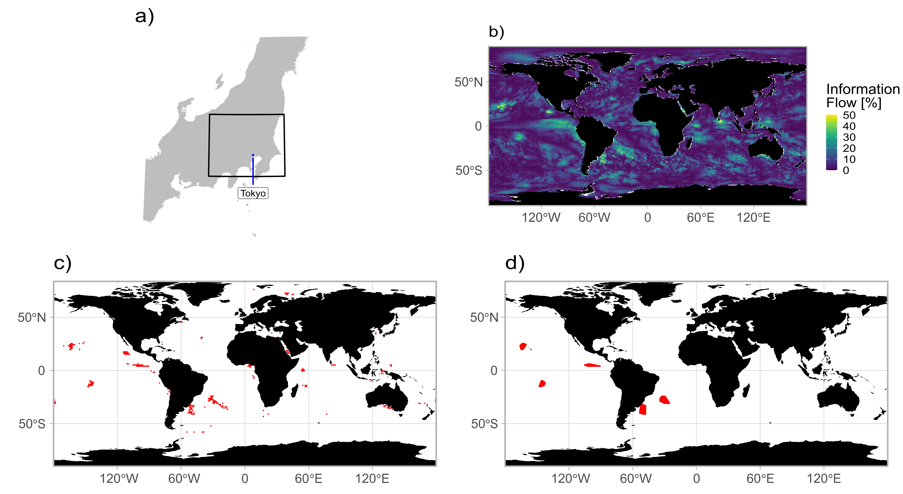
Utilizes SST forecast by SINTEX-F2 to provide predictors of the SAT in Kantō region
Selected region of SST as potential predictor
Oettli, P., M. Nonaka, I. Richter, H. Koshiba, Y. Tokiya, I. Hoshino, and S. K. Behera, 2022: Combining Dynamical and Statistical Modeling to Improve the Prediction of Surface Air Temperatures 2 Months in Advance: A Hybrid Approach. Front. Clim., 4, https://doi.org/10.3389/fclim.2022.862707.

Slide 70
Selection of all potential predictors
Feature selection (or not)
Machine learning

Slide 71
 | Acronym | Meaning | Hyperparameters
Neural Network | SLP | Single-Layer Perceptron (1 HL) | number of artificial neurons of the hidden layer weight regularization
 | MLP | Multi-Layer Perceptron (3 HL)
Random Forest | RF | Random Forest | number of variables randomly sampled as candidates at each split
Support Vector Machine | SVML | Support Vector Machine Linear Kernel | cost regularization parameter, which controls the smoothness of the fitted function
 | SVMR | Support Vector Machine Radial Kernel | cost regularization parameter, inverse kernel width
Boosting | XGBL | eXtreme Gradient Boosting Linear | maximum number of boosting iterations, L1 regularization, L2 regularization In the case of the tree-based model, the
 | XGBT | eXtreme Gradient Boosting Tree-based | maximum number of boosting iterations, maximum depth of a tree, learning rate, minimum loss reduction, subsample ratio of columns when constructing each tree, minimum sum of instance weight, and the subsample percentage
 | CBST | CatBoost | number of trees, depth of trees, learning rate, L2 regularization, the percentage of features to use at each iteration and the number of splits
Bayesian | BART | BARTmachine | number of trees to be grown, prior probability, base and power hyperparameters in tree prior probability, and the degrees of freedom for the inverse χ2 prior

Slide 72
Type | Acronym | Meaning
Neural Network | SLP | Single-Layer Perceptron (1 HL)
 | MLP | Multi-Layer Perceptron (3 HL)
Random Forest | RF | Random Forest
Support Vector Machine | SVML | Support Vector Machine Linear Kernel
 | SVMR | Support Vector Machine Radial Kernel
Boosting | XGBL | eXtreme Gradient Boosting Linear
 | XGBT | eXtreme Gradient Boosting Tree-based
 | CBST | CatBoost
Bayesian | BART | BARTmachine

Slide 73
Selection of all potential predictors
Feature selection (or not)
Machine learning
Optimization
Hybrid System

Slide 74
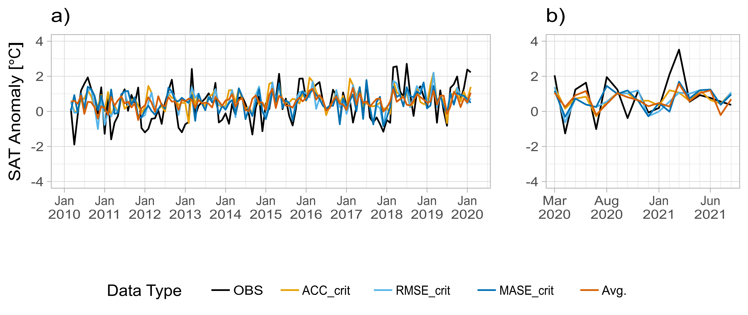
Validation subset
Test subset

Slide 75
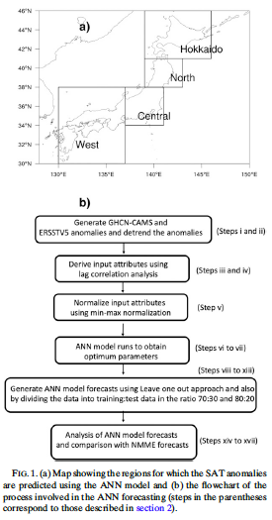
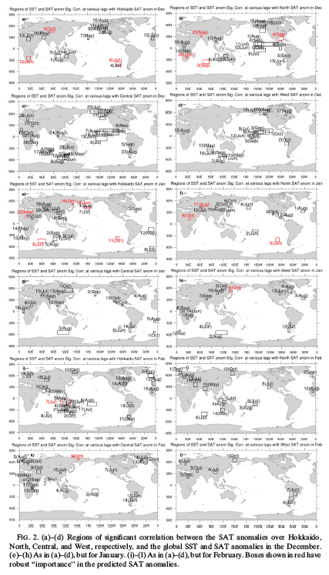
Ratnam, J. V., H. A. Dijkstra, and S. K. Behera, 2020: A machine learning based prediction system for the Indian Ocean Dipole. Sci Rep, 10, 284, https://doi.org/10.1038/s41598-019-57162-8.

Slide 76
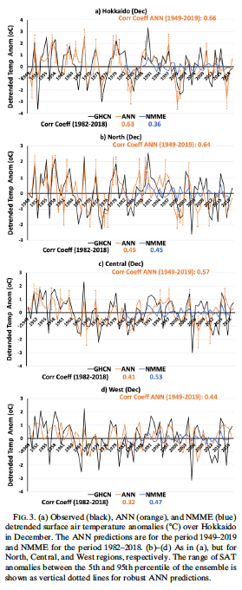
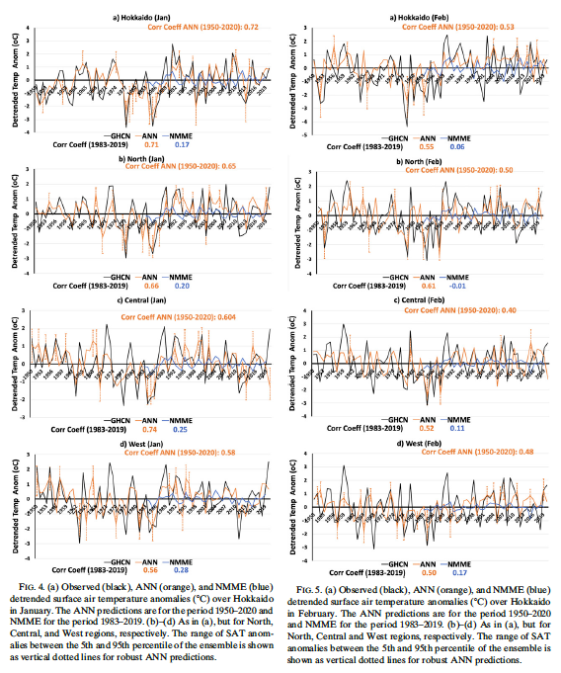

Slide 78
Deep Learning
Notes:
ANN is used in ML, but is also an important component of DL

Slide 79
0-D Tensor
1-D Tensor
2-D Tensor
N-D Tensor

Slide 80
Basic structure of an artificial neural network
b
i | Input layer | Inputs
o | Output layer | Targets
h | Hidden layer | Transformation of original inputs Invisible outputs, hence “hidden”
b | Bias | Allows the activation function to shift to the left or to the right
w | Weight | Steepness of the activation function
i
h
o
Feedforward
Neuron
Bias neuron
W

Slide 81
Basic structure of an artificial neural network
b
i
h₁
h₂
h_{n}
o
”Deep Learning”
…
depth

Slide 82
Input X
Chollet, F., 2018: Deep learning with Python. Manning Publications Co, 361 pp.
Layer (data transformation)
Weights
Layer (data transformation)
Weights
Predictions Y’
Notes:
How deep learning works

Slide 83
Input X
Chollet, F., 2018: Deep learning with Python. Manning Publications Co, 361 pp.
Layer (data transformation)
Weights
Layer (data transformation)
Weights
Finding the right values to improve Y’
Predictions Y’

Slide 84
Input X
Chollet, F., 2018: Deep learning with Python. Manning Publications Co, 361 pp.
Layer (data transformation)
Weights
Layer (data transformation)
Weights
Predictions Y’
True targets Y
Loss function
Loss score

Slide 85
Input X
Chollet, F., 2018: Deep learning with Python. Manning Publications Co, 361 pp.
Layer (data transformation)
Weights
Layer (data transformation)
Weights
Predictions Y’
True targets Y
Loss function
Quality of the network’s output
Loss score

Slide 86
Input X
Chollet, F., 2018: Deep learning with Python. Manning Publications Co, 361 pp.
Layer (data transformation)
Weights
Layer (data transformation)
Weights
Predictions Y’
True targets Y
Loss function
Optimizer
Loss score

Slide 87
Input X
Chollet, F., 2018: Deep learning with Python. Manning Publications Co, 361 pp.
Layer (data transformation)
Weights
Layer (data transformation)
Weights
Predictions Y’
True targets Y
Backpropagation
Weights update
Loss function
Optimizer
Loss score

Slide 88
Input X
Chollet, F., 2018: Deep learning with Python. Manning Publications Co, 361 pp.
Layer (data transformation)
Weights
Layer (data transformation)
Weights
Predictions Y’
True targets Y
Loss function
Optimizer
Loss score

Slide 89
i
h₁
h₂
o
Densely (or fully) connected network

Slide 90
Fully Connected
Input
Convolution
Pooling
Convolutional Neural Network

Slide 91


The fundamental difference between a densely connected layer and a convolution layer is this: dense layers learn global patterns in their input feature space[…], whereas convolution layers learn local patterns.
Chollet, F., and J. J. Allaire, 2018: Deep learning with R. Manning Publications Co, 335 pp.
Because these are local features, they can be found anywhere in a “picture”;
Learning is hierarchicel, each convolution being dedicated to learn different charaterictics of the “picture” (i.e., edges, shapes,…)
Notes:
I use “picture” as a general term because convets where first develops to retrieve patterns in pictures. We will see soon how it applies to earth sciences

Slide 92

input (2-D tensor)
97 | 90 | 21 | 4 | 53 | 90 | 52 | 41
39 | 5 | 21 | 49 | 56 | 65 | 54 | 41
52 | 94 | 72 | 21 | 3 | 87 | 53 | 12
19 | 29 | 40 | 34 | 7 | 82 | 37 | 51
50 | 93 | 99 | 1 | 2 | 61 | 39 | 17
24 | 67 | 54 | 72 | 6 | 54 | 15 | 74
The kernel is used to extract feature maps from the input, via a dot product, and the pooling reduces the amount of information
kernel (convolutional filter)
1 | 1
1 | 1
pooling (window and function)
$$\max{(fm)}$$

Slide 93
input (2-D tensor)
97 | 90 | 21 | 4 | 53 | 90 | 52 | 41
39 | 5 | 21 | 49 | 56 | 65 | 54 | 41
52 | 94 | 72 | 21 | 3 | 87 | 53 | 12
19 | 29 | 40 | 34 | 7 | 82 | 37 | 51
50 | 93 | 99 | 1 | 2 | 61 | 39 | 17
24 | 67 | 54 | 72 | 6 | 54 | 15 | 74
97 | 90
39 | 5
97+90+39+5 = 231
97 | 90 | 21 | 4 | 53 | 90 | 52 | 41
39 | 5 | 21 | 49 | 56 | 65 | 54 | 41
52 | 94 | 72 | 21 | 3 | 87 | 53 | 12
19 | 29 | 40 | 34 | 7 | 82 | 37 | 51
50 | 93 | 99 | 1 | 2 | 61 | 39 | 17
24 | 67 | 54 | 72 | 6 | 54 | 15 | 74
1 | 1
1 | 1
x | x
x | x
kernel (convolutional filter)
1 | 1
1 | 1
pooling (window and function)
$$\max{(fm)}$$

Slide 94
input (2-D tensor)
97 | 90 | 21 | 4 | 53 | 90 | 52 | 41
39 | 5 | 21 | 49 | 56 | 65 | 54 | 41
52 | 94 | 72 | 21 | 3 | 87 | 53 | 12
19 | 29 | 40 | 34 | 7 | 82 | 37 | 51
50 | 93 | 99 | 1 | 2 | 61 | 39 | 17
24 | 67 | 54 | 72 | 6 | 54 | 15 | 74
21 | 4
21 | 49
21+4+21+49 = 95
97 | 90 | 21 | 4 | 53 | 90 | 52 | 41
39 | 5 | 21 | 49 | 56 | 65 | 54 | 41
52 | 94 | 72 | 21 | 3 | 87 | 53 | 12
19 | 29 | 40 | 34 | 7 | 82 | 37 | 51
50 | 93 | 99 | 1 | 2 | 61 | 39 | 17
24 | 67 | 54 | 72 | 6 | 54 | 15 | 74
1 | 1
1 | 1
x | x
x | x
kernel (convolutional filter)
1 | 1
1 | 1
pooling (window and function)
$$\max{(fm)}$$

Slide 95
input (2-D tensor)
97 | 90 | 21 | 4 | 53 | 90 | 52 | 41
39 | 5 | 21 | 49 | 56 | 65 | 54 | 41
52 | 94 | 72 | 21 | 3 | 87 | 53 | 12
19 | 29 | 40 | 34 | 7 | 82 | 37 | 51
50 | 93 | 99 | 1 | 2 | 61 | 39 | 17
24 | 67 | 54 | 72 | 6 | 54 | 15 | 74
97 | 90 | 21 | 4 | 53 | 90 | 52 | 41
39 | 5 | 21 | 49 | 56 | 65 | 54 | 41
52 | 94 | 72 | 21 | 3 | 87 | 53 | 12
19 | 29 | 40 | 34 | 7 | 82 | 37 | 51
50 | 93 | 99 | 1 | 2 | 61 | 39 | 17
24 | 67 | 54 | 72 | 6 | 54 | 15 | 74
kernel (convolutional filter)
1 | 1
1 | 1
1 | 1
1 | 1
x | x
x | x
pooling (window and function)
$$\max{(fm)}$$

Slide 96
input (2-D tensor)
97 | 90 | 21 | 4 | 53 | 90 | 52 | 41
39 | 5 | 21 | 49 | 56 | 65 | 54 | 41
52 | 94 | 72 | 21 | 3 | 87 | 53 | 12
19 | 29 | 40 | 34 | 7 | 82 | 37 | 51
50 | 93 | 99 | 1 | 2 | 61 | 39 | 17
24 | 67 | 54 | 72 | 6 | 54 | 15 | 74
231 | 95 | 264 | 188
194 | 167 | 179 | 153
234 | 226 | 123 | 145
kernel (convolutional filter)
1 | 1
1 | 1
pooling (window and function)
$$\max{(fm)}$$

Slide 97
input (2-D tensor)
97 | 90 | 21 | 4 | 53 | 90 | 52 | 41
39 | 5 | 21 | 49 | 56 | 65 | 54 | 41
52 | 94 | 72 | 21 | 3 | 87 | 53 | 12
19 | 29 | 40 | 34 | 7 | 82 | 37 | 51
50 | 93 | 99 | 1 | 2 | 61 | 39 | 17
24 | 67 | 54 | 72 | 6 | 54 | 15 | 74
231 | 95 | 264 | 188
194 | 167 | 179 | 153
234 | 226 | 123 | 145
kernel (convolutional filter)
1 | 1
1 | 1
pooling (window and function)
234
$$\max{(fm)}$$

Slide 98
input (2-D tensor)
97 | 90 | 21 | 4 | 53 | 90 | 52 | 41
39 | 5 | 21 | 49 | 56 | 65 | 54 | 41
52 | 94 | 72 | 21 | 3 | 87 | 53 | 12
19 | 29 | 40 | 34 | 7 | 82 | 37 | 51
50 | 93 | 99 | 1 | 2 | 61 | 39 | 17
24 | 67 | 54 | 72 | 6 | 54 | 15 | 74
231 | 95 | 264 | 188
194 | 167 | 179 | 153
234 | 226 | 123 | 145
kernel (convolutional filter)
1 | 1
1 | 1
pooling (window and function)
234 | 264
$$\max{(fm)}$$

Slide 99
input (2-D tensor)
97 | 90 | 21 | 4 | 53 | 90 | 52 | 41
39 | 5 | 21 | 49 | 56 | 65 | 54 | 41
52 | 94 | 72 | 21 | 3 | 87 | 53 | 12
19 | 29 | 40 | 34 | 7 | 82 | 37 | 51
50 | 93 | 99 | 1 | 2 | 61 | 39 | 17
24 | 67 | 54 | 72 | 6 | 54 | 15 | 74
231 | 95 | 264 | 188
194 | 167 | 179 | 153
234 | 226 | 123 | 145
kernel (convolutional filter)
234 | 264
1 | 1
1 | 1
pooling (window and function)
$$\max{(fm)}$$

Slide 100

97 | 90 | 21 | 4 | 53 | 90 | 52 | 41
39 | 5 | 21 | 49 | 56 | 65 | 54 | 41
52 | 94 | 72 | 21 | 3 | 87 | 53 | 12
19 | 29 | 40 | 34 | 7 | 82 | 37 | 51
50 | 93 | 99 | 1 | 2 | 61 | 39 | 17
24 | 67 | 54 | 72 | 6 | 54 | 15 | 74
231 | 95 | 264 | 188
194 | 167 | 179 | 153
234 | 226 | 123 | 145
$$\max{(fm)}$$
1 | 1
1 | 1
234 | 264

Slide 102
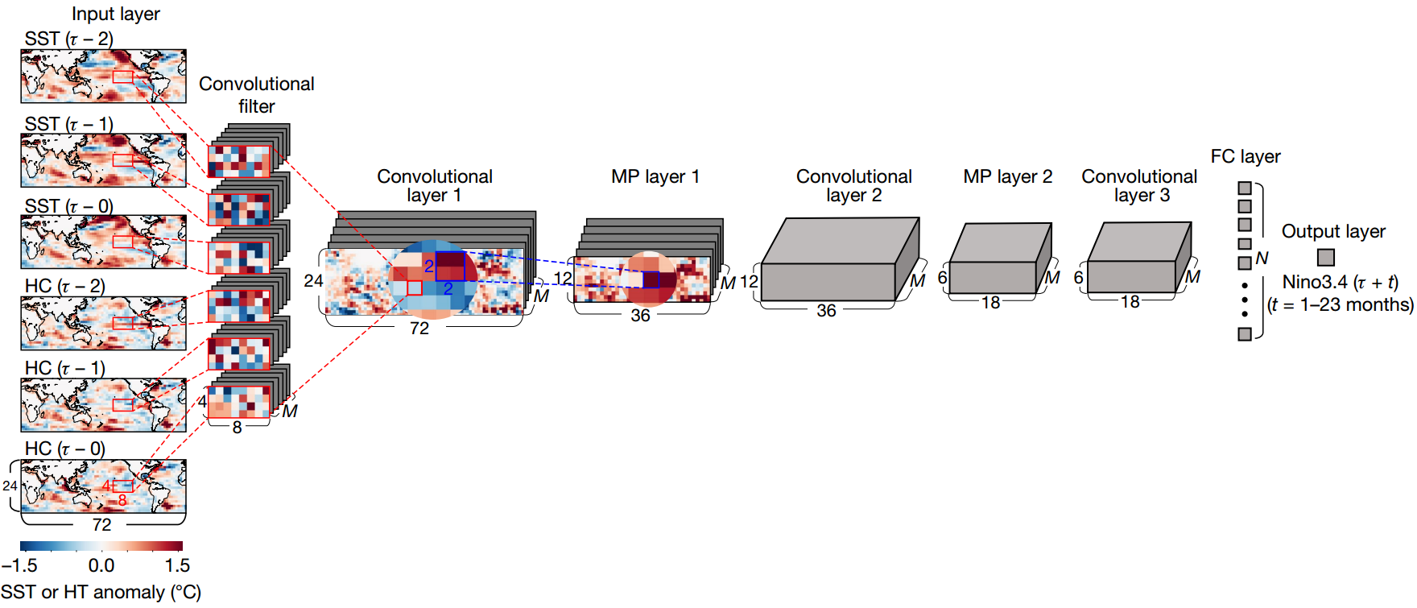
Ham, Y.-G., J.-H. Kim, and J.-J. Luo, 2019: Deep learning for multi-year ENSO forecasts. Nature, 1–5, https://doi.org/10.1038/s41586-019-1559-7.

Slide 103
Layer (type) Output Shape Param #
=========================================================================================================================
conv2d_2 (Conv2D) (None, 72, 24, M) ((8x4x6)+1)xM
max_pooling2d_1 (MaxPooling2D) (None, 36, 12, M) 0
dropout_2 (Dropout) (None, 36, 12, M) 0
conv2d_1 (Conv2D) (None, 36, 12, M) ((4x2xM)+1)xM
max_pooling2d (MaxPooling2D) (None, 18, 6, M) 0
dropout_1 (Dropout) (None, 18, 6, M) 0
conv2d (Conv2D) (None, 18, 6, M) ((4x2xM)+1)xM
flatten (Flatten) (None, 3240) 0
dropout (Dropout) (None, 3240) 0
dense_1 (Dense) (None, N) ((18x6xM)+1)xN
dense (Dense) (None, 1) N+1
=========================================================================================================================

Slide 105
In order to get access to a much richer hypothesis space that would benefit from deep representations, you need a non-linearity, or activation function.
Chollet, F., and J. J. Allaire, 2018: Deep learning with R. Manning Publications Co, 335 pp.
In other words, introducing non-linearity by transforming the data between hidden layers
Important choice, which define how the network will learn from the input

Slide 106
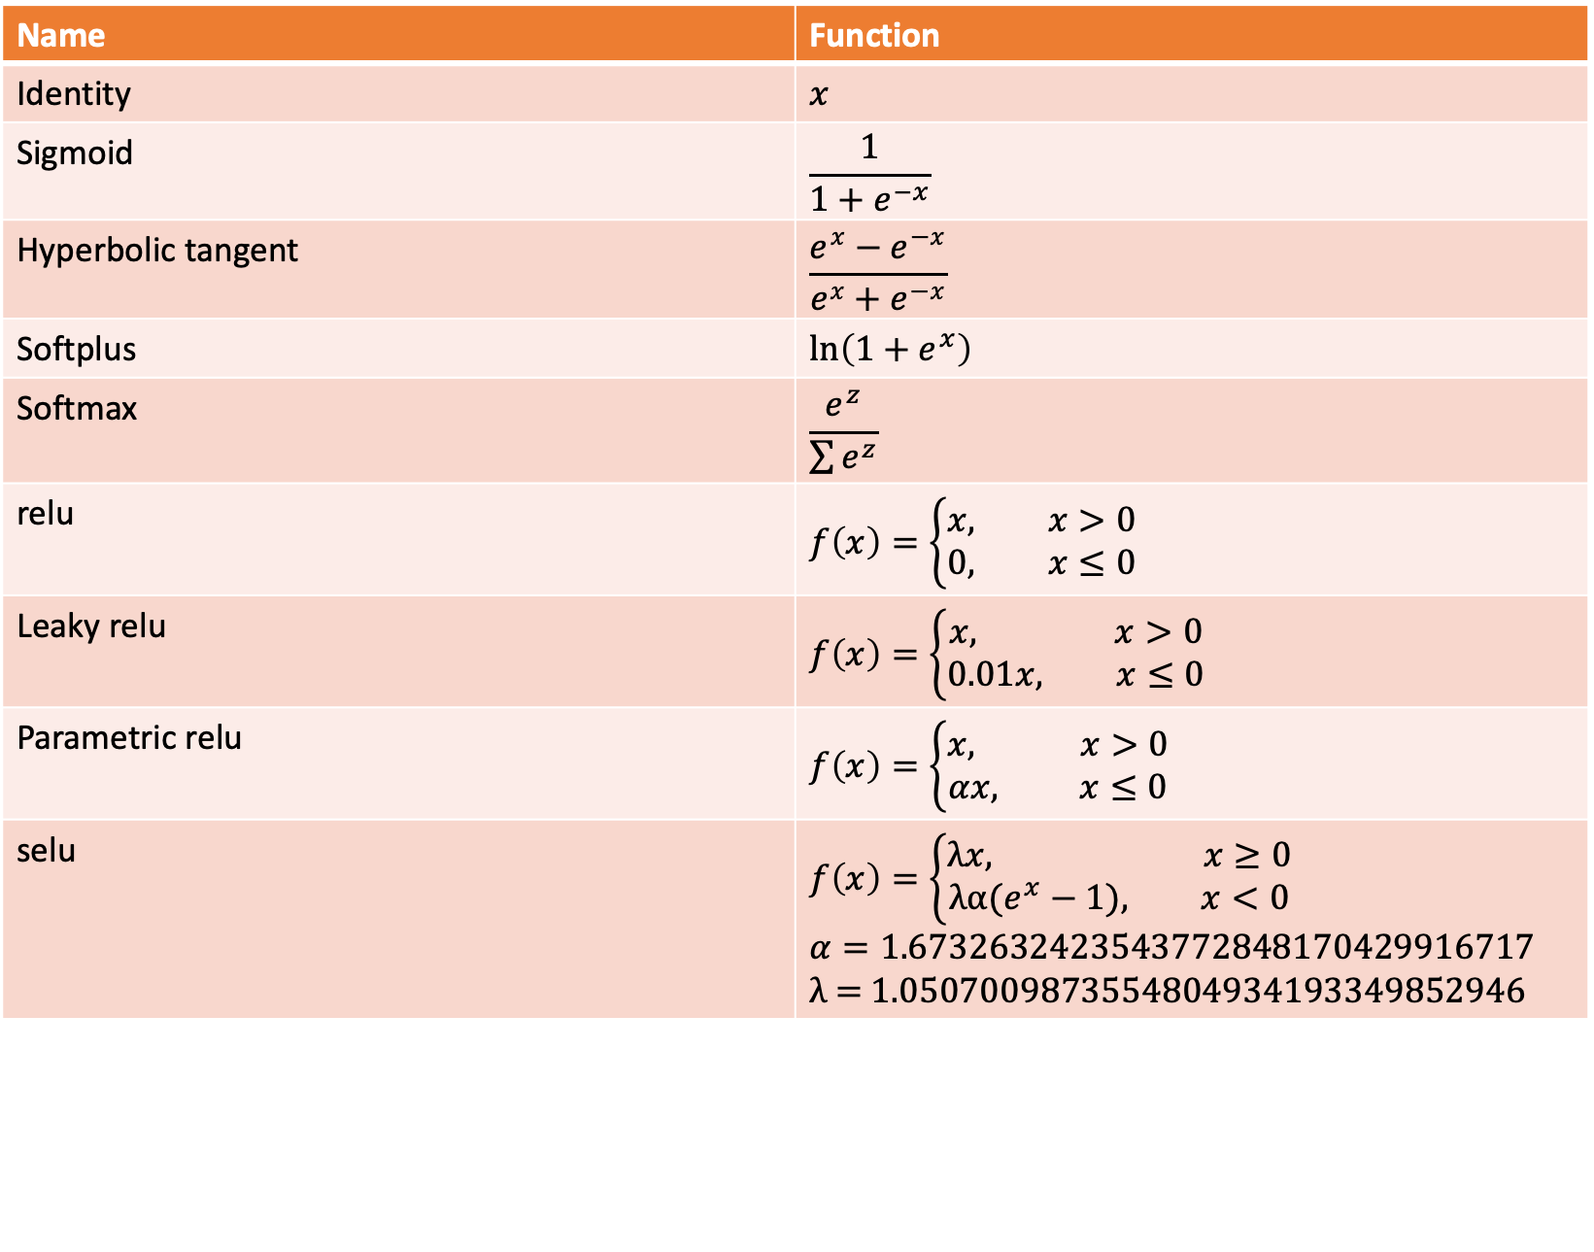
Name | Function
Identity | $$x$$
Sigmoid | $$\frac{1}{1+e^{−x}}$$
Hyperbolic tangent | $$\frac{e^{x}−e^{−x}}{e^{x}+e^{−x}}$$
Softplus | $$\ln\left(1+e^{x}\right)$$
Softmax | $$\frac{e^{z}}{\sum{e^{z}}}$$
relu | $$f\left(x\right)=\left\{\begin{aligned}x, x>0 \\ 0, x≤0\end{aligned}\right.$$
Leaky relu | $$f\left(x\right)=\left\{\begin{aligned}x, x>0 \\ 0.01x, x≤0\end{aligned}\right.$$
Parametric relu | $$f\left(x\right)=\left\{\begin{aligned}x, x>0 \\ αx, x≤0\end{aligned}\right.$$
selu | $$f\left(x\right)=\left\{\begin{aligned}λx, x≥0 \\ λα(e^{x}−1), x<0\end{aligned}\right.$$ $$α=\text{1.6732632423543772848170429916717}$$ λ = 1.0507009873554804934193349852946

Slide 107
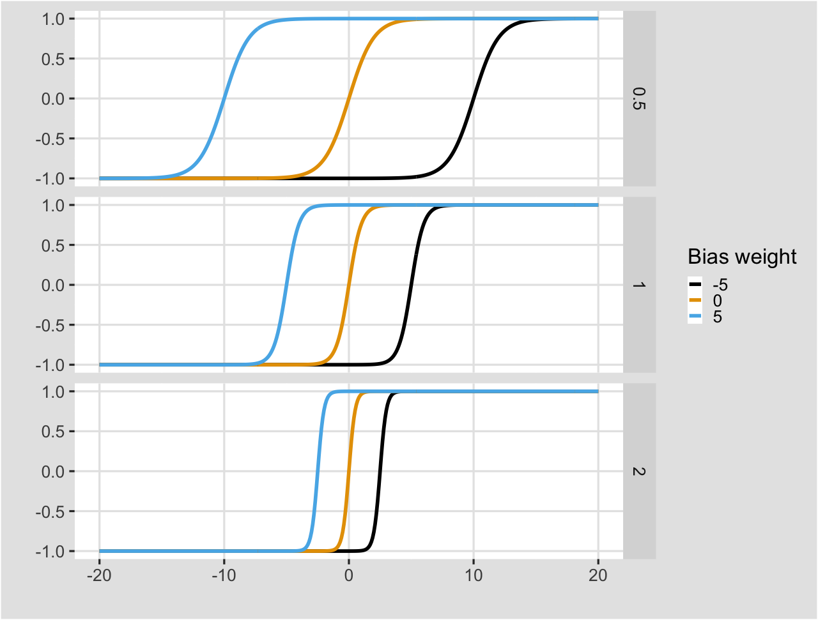


tanh = $\frac{e^{x}−e^{−x}}{e^{x}+e^{−x}}$
i
$$tanh(i∗w_{0}+b∗w_{1})$$
w₀
w₁
b

Slide 108
The purpose of loss functions is to compute the quantity that a model should seek to minimize during training.
Keras API reference, https://keras.io/api/
It represents a measure of success

Slide 109
The quantity that will be minimized during training. It represents a measure of success for the task at hand.
Chollet, F., and J. J. Allaire, 2018: Deep learning with R. Manning Publications Co, 335 pp.
It represents a measure of success

Slide 110
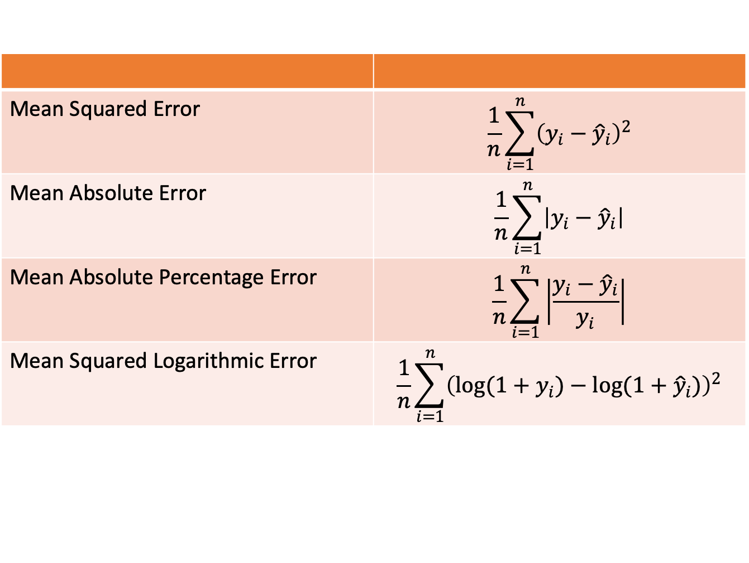
Mean Squared Error | $$\frac{1}{n}\sum_{i=1}^{n}{{\left(y_{i}−{\hat{y}}_{i}\right)}^{2}}$$
Mean Absolute Error | $$\frac{1}{n}\sum_{i=1}^{n}{\left|y_{i}−{\hat{y}}_{i}\right|}$$
Mean Absolute Percentage Error | $$\frac{1}{n}\sum_{i=1}^{n}{\left|\frac{y_{i}−{\hat{y}}_{i}}{y_{i}}\right|}$$
Mean Squared Logarithmic Error | $$\frac{1}{n}\sum_{i=1}^{n}{{\left(\log{(1+y_{i})}−\log{(1+{\hat{y}}_{i})}\right)}^{2}}$$

Slide 111
Determines how the network will be updated based on the loss function.
Chollet, F., and J. J. Allaire, 2018: Deep learning with R. Manning Publications Co, 335 pp.
Its task is to mimimize the loss function and implements a specific variant of gradient descent

Slide 112
SGD | Stochastic Gradient Descent | Iterative method for optimizing an objective function
RMSprop | Root Mean Squared propagation | Adaptative learning rate for each of the parameter. Divide the learning rate for a weight by a running average of the magnitudes of recent gradients for that weight
Adam | Adaptive moment estimation | Update of the previous. Running averages of both the gradients and the second moments of the gradients are used

Slide 113
The key idea is to randomly drop units (along with their connections) from the neural network during training. This prevents units from co-adapting too much.
Srivastava, N., G. Hinton, A. Krizhevsky, I. Sutskever, and R. Salakhutdinov, 2014: Dropout: A Simple Way to Prevent Neural Networks from Overfitting. Journal of Machine Learning Research, 15, 1929–1958.

Slide 114
i
h₁
h₂
o

Slide 115
i
h₁
h₂
o
i
h₁
h₂
o
~0.5 dropout

Slide 117
Liu, J., Y. Tang, Y. Wu, T. Li, Q. Wang, and D. Chen, 2021: Forecasting the Indian Ocean Dipole With Deep Learning Techniques. Geophys Res Lett, 48, https://doi.org/10.1029/2021GL094407.

Slide 118
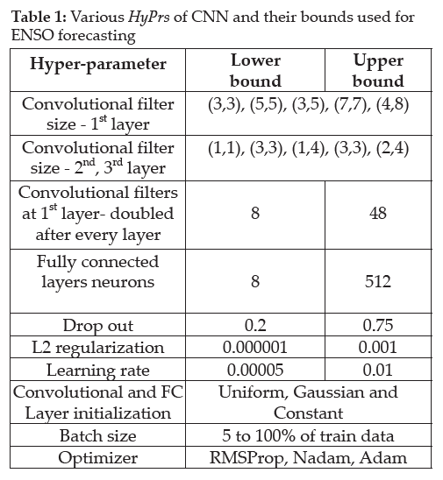
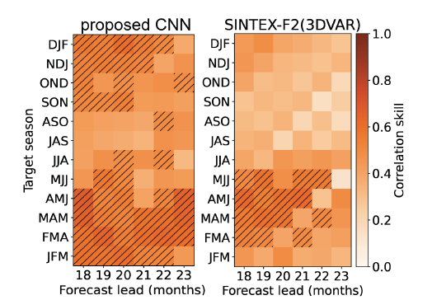
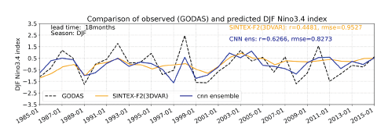
Patil, K. R., T. Doi, P. Oettli, J. V. Ratnam, and S. K. Behera, 2021: Improving long-lead predictions of ENSO using convolutional neural networks. CLIVAR Exchanges Special Issue: Advances in Climate Prediction Using Artificial Intelligence, 81, 8–11.

